Slide 1
Voyage Vista : Illuminating Insights from Uber Expeditionary Analysis
NM ID : A4015A0098FBBB281174DFDD89B648B7
Notes:
Project Title
:
Voyage Vista : Illuminating Insights from Uber Expeditionary Analysis

Slide 2
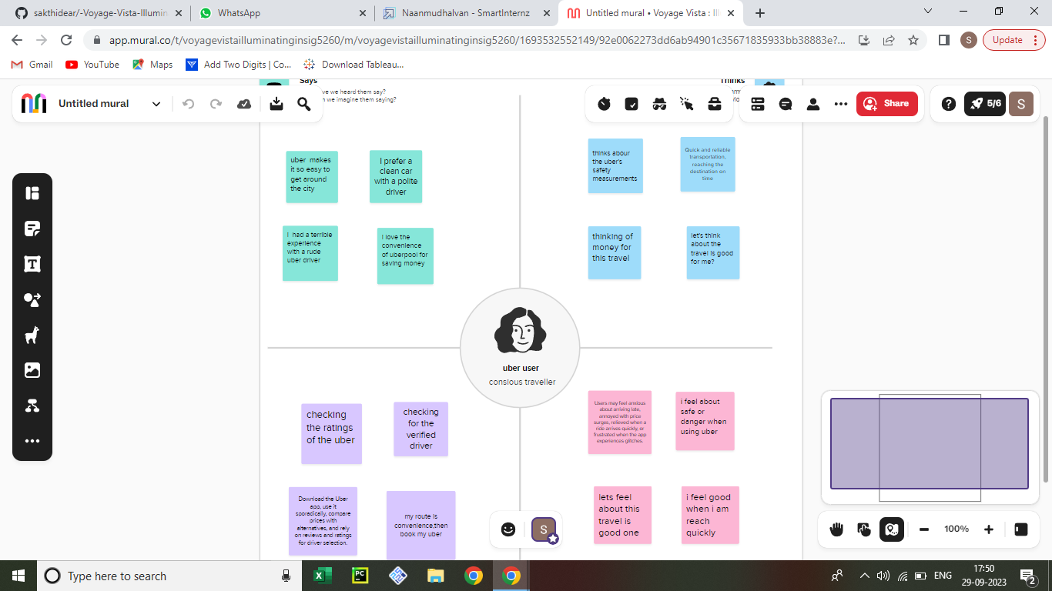

Slide 3
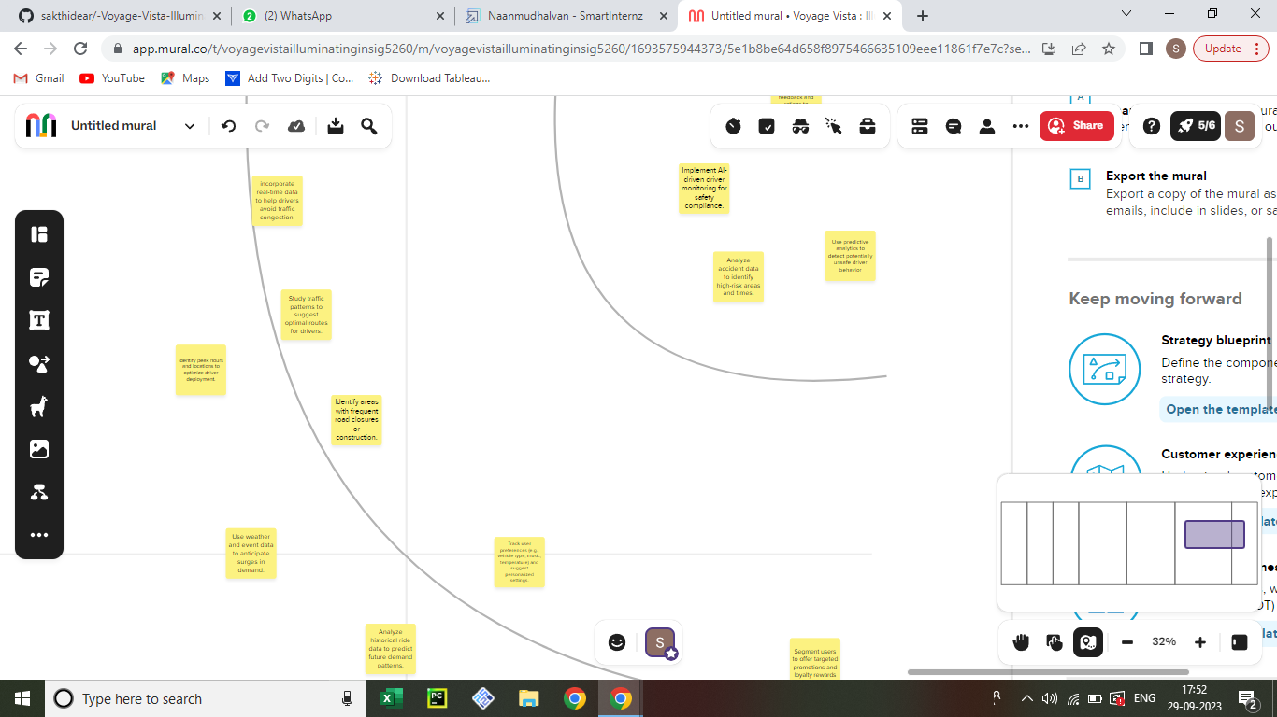

Slide 4
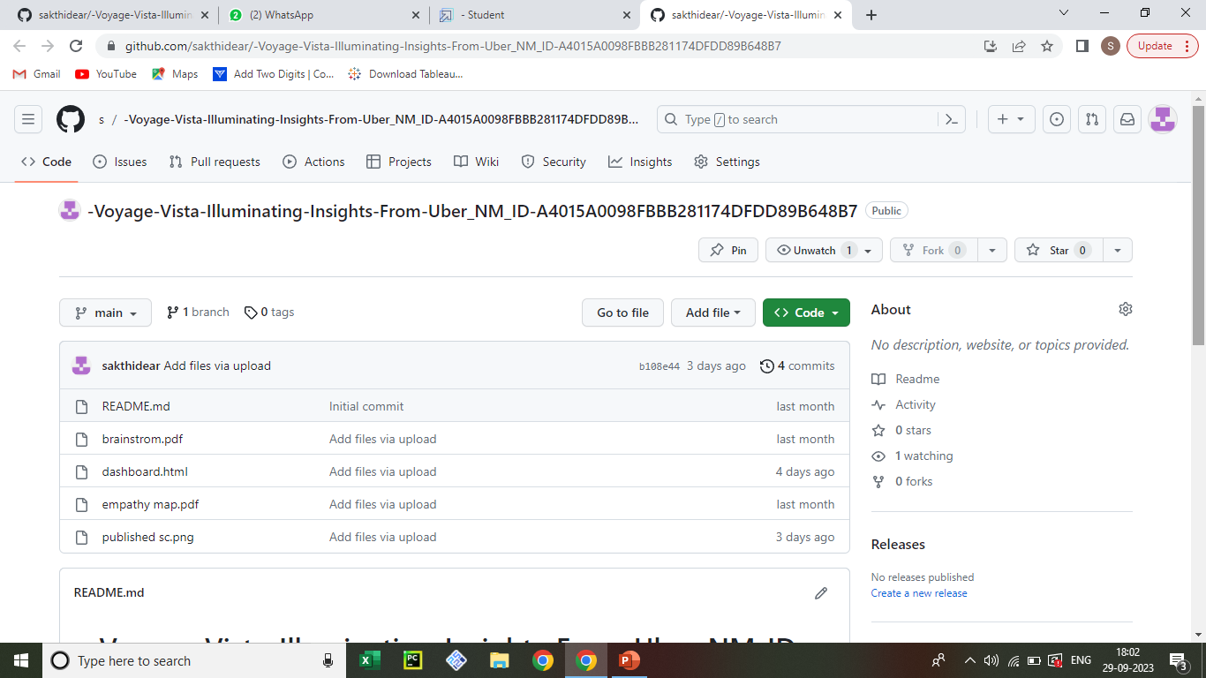
https://github.com/sakthidear/-Voyage-Vista-Illuminating-Insights-From-Uber_NM_ID-A4015A0098FBBB281174DFDD89B648B7

Slide 5
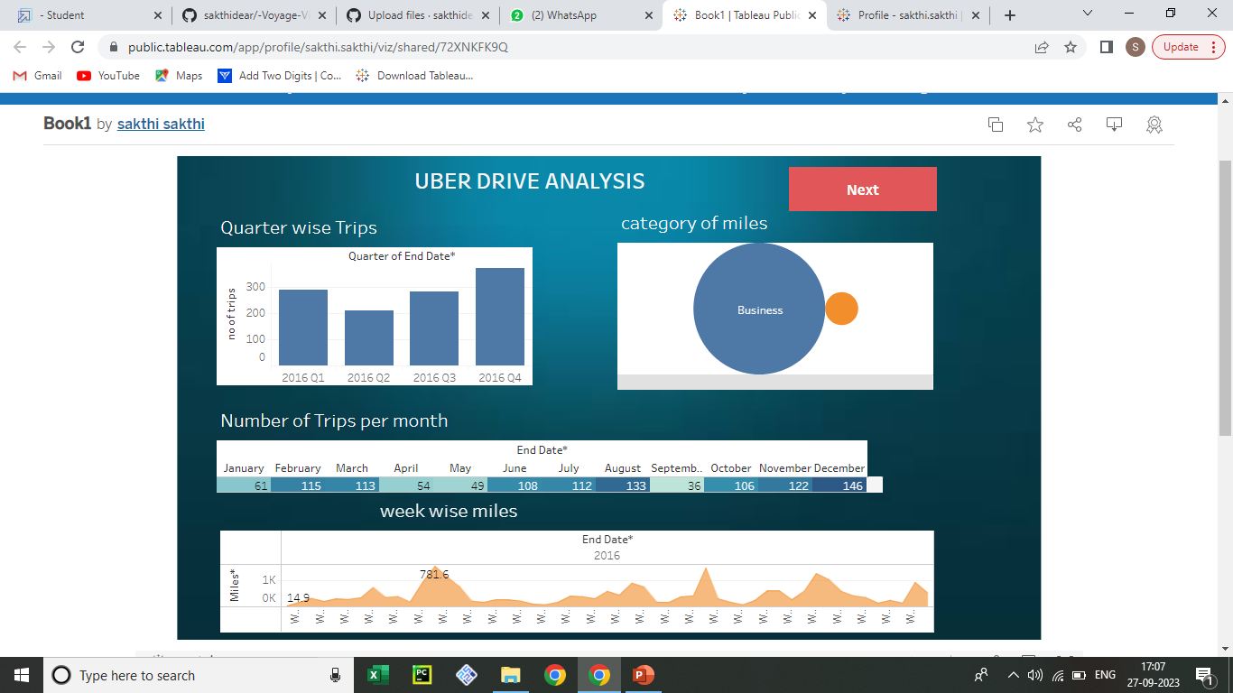
s://https://public.tableau.com/shared/72XNKFK9Q?:display_count=n&:origin=viz_share_link

Slide 6
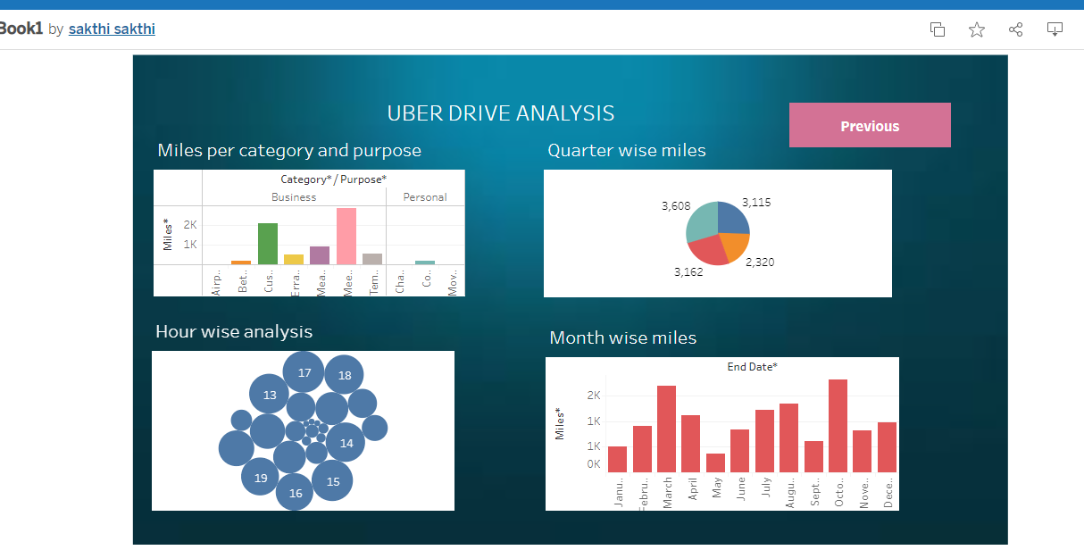
https://public.tableau.com/shared/72XNKFK9Q?:display_count=n&:origin=viz_share_link

Slide 7
https://public.tableau.com/views/Book2_16957317760580/Story1?:language=en-US&publish=yes&:display_count=n&:origin=viz_share_link

Slide 8
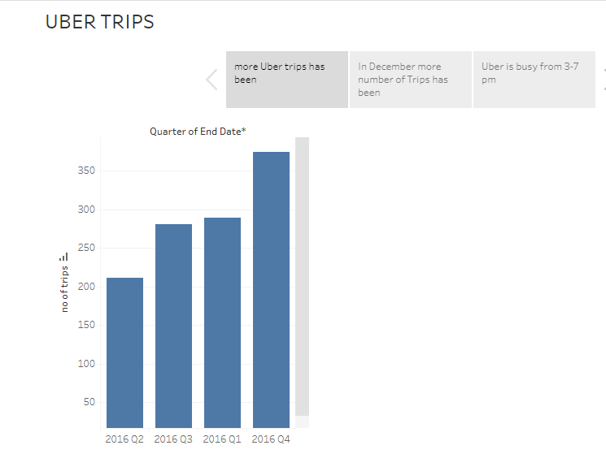

Slide 9
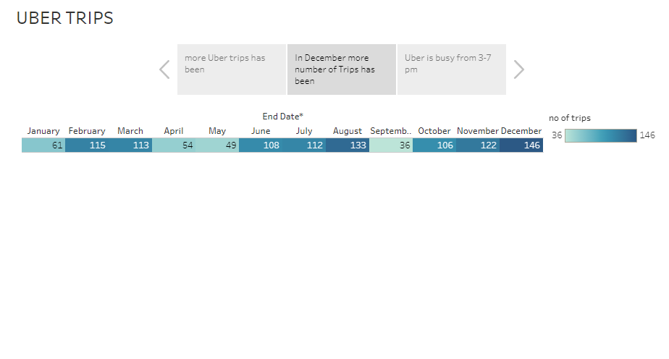

Slide 10
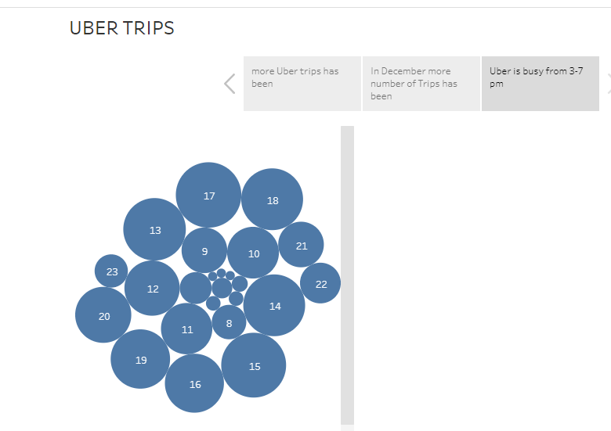

Slide 11
Thank You

